Slide 1
Final Project: Dealing with Data
Nahel Rifai, Lauren Yee, & Linh Tran

Slide 2
What?
We are determining whether we should open a new restaurant serving a certain kind of food in Times Square or not depending on how close similar restaurants are.

Slide 3
Why?
There are 308 restaurants in Times Square (as recorded to date in the NYC Open Data), so if you to make a restaurant, you should know your competition.

Slide 4
How?
We downloaded the data from NYC Open Data on the Times Square Food & Beverage Locations.
(https://data.cityofnewyork.us/Business/Times-Square-Food-Beverage-Locations/kh2m-kcyz)

Slide 5
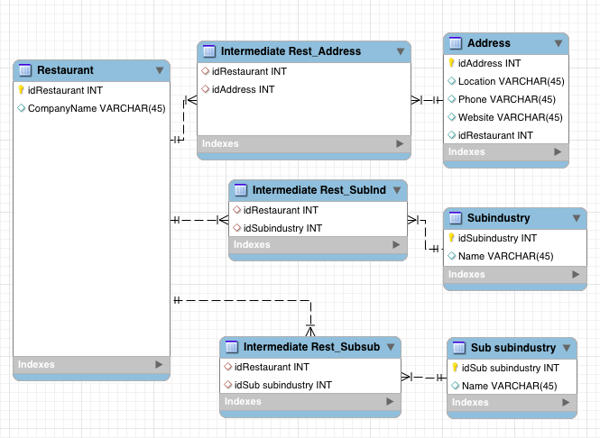
How?
We imported all the data to mySQL, and created the schema.

Slide 6
How?
We converted the addresses of the locations into geolocations (coordinates) with Google Maps API.
With Python, we also calculated the distance between geolocations. This is the direct distance between the coordinates.

Slide 7
How?
Using Python, we let users input the location and type of food to filter through the database, returning the five closest restaurants serving the same type of food, the distance in relation to the input location and the graph of the distance.

Slide 8
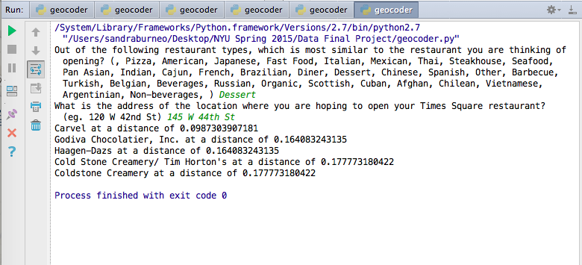
How?

Slide 9
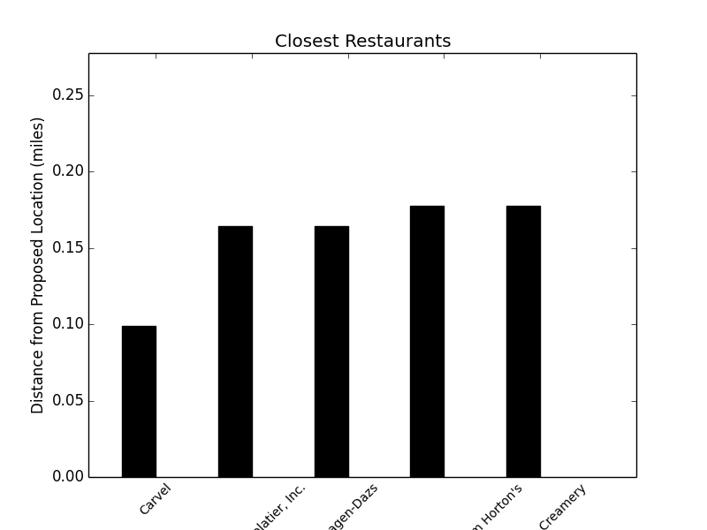
How?

Slide 10
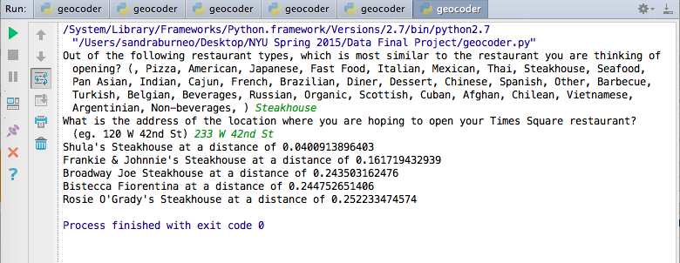
How?

Slide 11
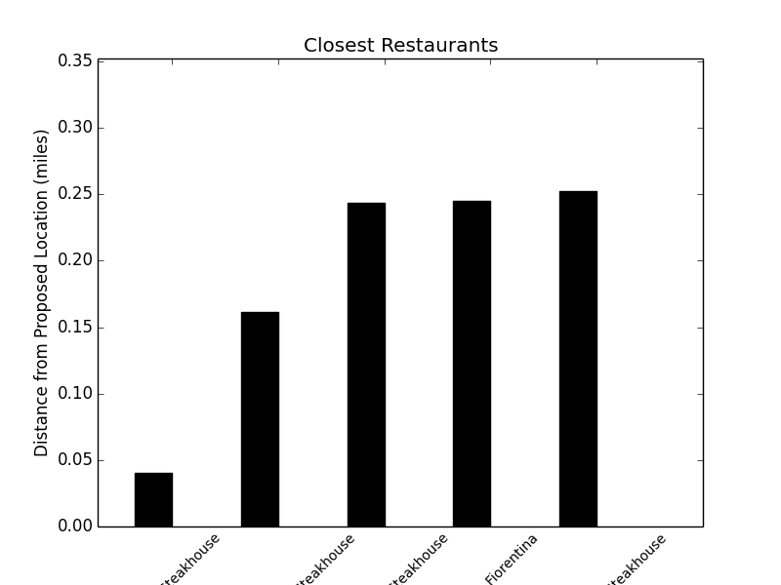
How?

Slide 12
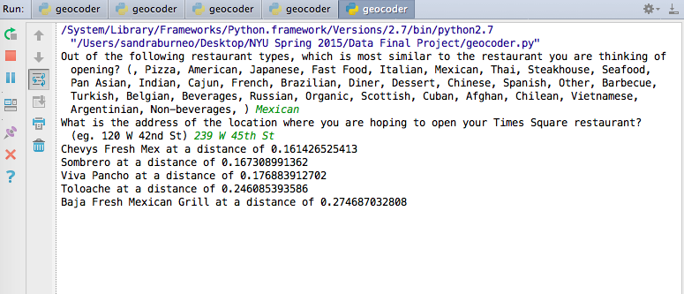
How?

Slide 13
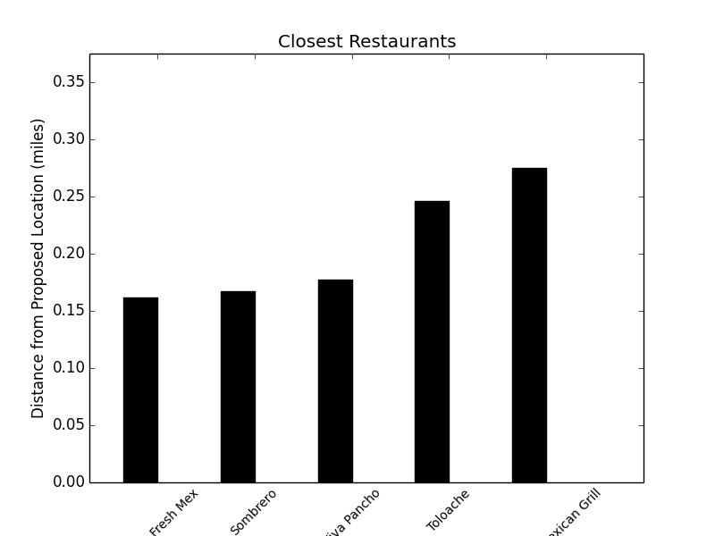
How?

